Slide 1
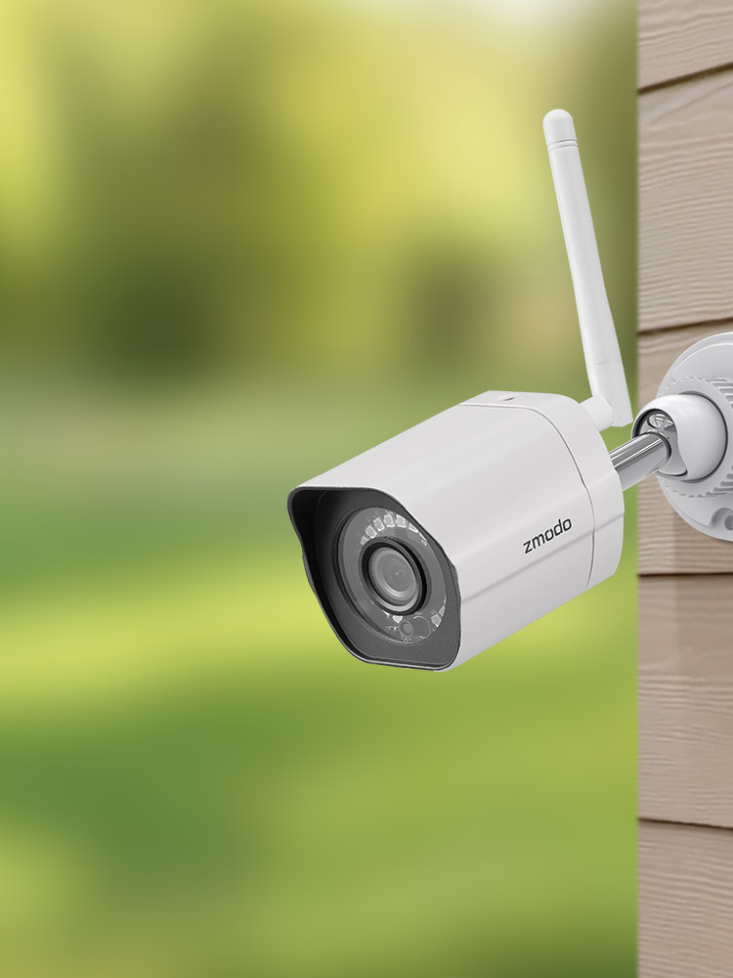
PRO-TECHT
ST.JOSEPH’S COLLEGE
OF ENGINEERING
Kousika v
Malathi v
Ragapriya r

Slide 2


Slide 3

BEHAVIOUR ANALYSIS
CHARACTERISTICS OF SUSPICIOUS BEHAVIOUR
Edginess
Tension
Freezing
Contradictory message of the corporal language
PARAMETERS OF CORPORAL LANGUAGE ALLOWING FOR DETECTION OF SUSPICIOUS BEHAVIOUR
Rhythm and movement (eyes, hands, legs, head)
Tension and freezing of diverse muscles (face, hands etc.,)
Tone and voice
Eyes
TOOLS FOR INVESTIGATION
Timing
Movement of body and hands
Distance, Height
Eyes(use of different looking ways)

Slide 4
BASIC CONDITIONS TO BE DETECTED
DEFENSES AND BARRIERS
Hand crossed on the chest and fallen head with tight lips.
Hands hiding parts of the body.
TENSION
Superficial breathing with strongly interlaced hands or fingers.
Lack of flexibility and lack of coordination of movements.
NERVOUSNESS
Quake in the legs, in the hands and lips with threatening gestures and contracted lips.
Crosses arms and legs with looks of worry and anxiety.
Shrike shoulders lifted with hidden hands.
Suspicious movement of eyes (looking down to left or horizontal right.

Slide 5
INSECURITY
Numerous head movements and small movements of hands and arms.
Lack of vitality in movement with short steps.
CONTRADICTIONS
Incomplete smile and threatening facial features with retiring legs.
Smile with frozen body, cold looking closed gestures

Slide 6
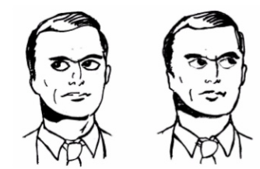
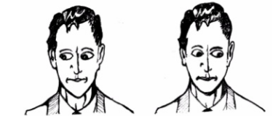
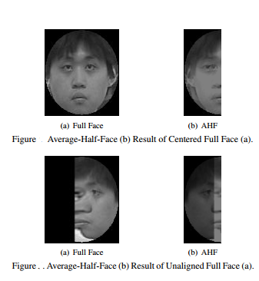
IRIS MOVEMENT:
Horizontal left and right looks indicate identifying new sounds and remembering known sounds.
Looking down left that indicates decision making and looking up indicates creating images.
FACE FUSE
Face tracking with cylinder head models is used to fuse faces and identify them using still face recognition method, Eigen faces Gaussian weights and average half face method.

Slide 7
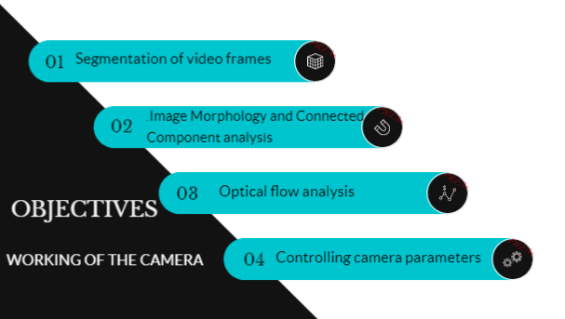
IMAGE PROCESSING

Slide 8

BACKGROUND SUBTRACTION
Resultant background subtracted image is obtained from two distinguishable frameworks depending on the threshold frequencies.
Background frame
Frame at time t
Resultant image
FRAME DIFFERENCING
The figures below show two consecutive frames taken from a video and their resultant frame difference. This is followed by erosion on an unfiltered frame.
Frame at time t
Frame at time t-1
Resultant image

Slide 9
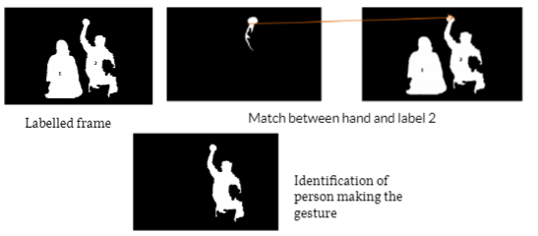
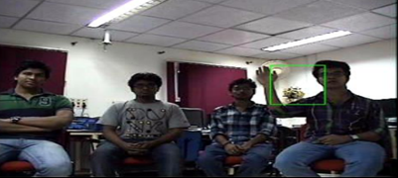
CONNECTED COMPONENT LABELLING
Connected component labeling applied to label the two people in the video separately and then a match is made between the moving hand and the labels to detect the person making the gesture.
OPTICAL FLOW ANALYSIS ON IP CAMERA FEED AND MOTION DETECTION
Optical flow technique applied on a live feed obtained from an IP camera. The bounding box shown indicates the region in which motion was detected.
Motion detected

Slide 10

WEAPON DETECTION
Detect human in an image
Extraction of features for each segment
Design of neural network based classifier to classify a single type of weapon versus non-weapon
Computation time required to detect a weapon directly in an image as compared to detection of a weapon after human detection
Detection of segment containing knife in the detected image segment containing human

Slide 11
SEGMENTATION
Large image need to be split into small segments. It is carried out through sliding window mechanism.
FEATURE EXTRACTION
HOG feature description is used as it can describe the edges of knife blade. Approximate shape of knife can be detected.
CLASSIFICATION
Classification of image segment as weapon or non-weapon could be identified using artificial neural networks trained through supervised or unsupervised learning algorithms.
Alert
Decision Making
No Alert

Slide 12
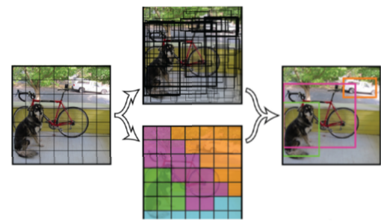
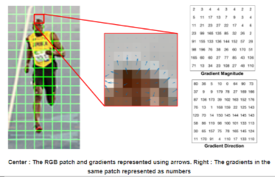
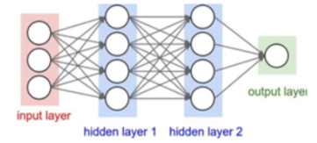
HOG
The histogram of oriented gradients (HOG) is a feature descriptor used in computer vision image processing for the purpose of object detection
SLIDING WINDOW
It is moved horizontally by certain number of pixels to find the desired image segment.
ARTIFICIAL NEURAL NETWORKS
They are inspired by biological neural networks. An artificial neuron that receives a signal can process it and then signal additional artificial neurons connected to it.

Slide 13

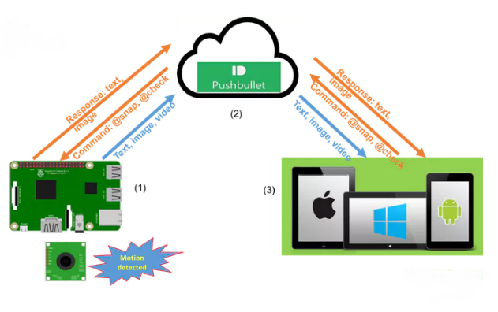
NOTIFICATION FROM CAMERA TO MOBILE
Step 1: Setup Pushbullet
Step 2: Download Software
Step 3: Flash Image to Pi
Step 4: Enter the Pushbullet Access Token
Step 5: Play Around
UNDER THE HOOD:
There are 2 python files you need to care of, they are main.py and push.py.
main.py is all about logic of application and push.py takes care sending notification and receive the command.
main.py | push.py
Initialize two major objects at first Camera Initialize Detect Motion At command received | init push manager

Slide 14

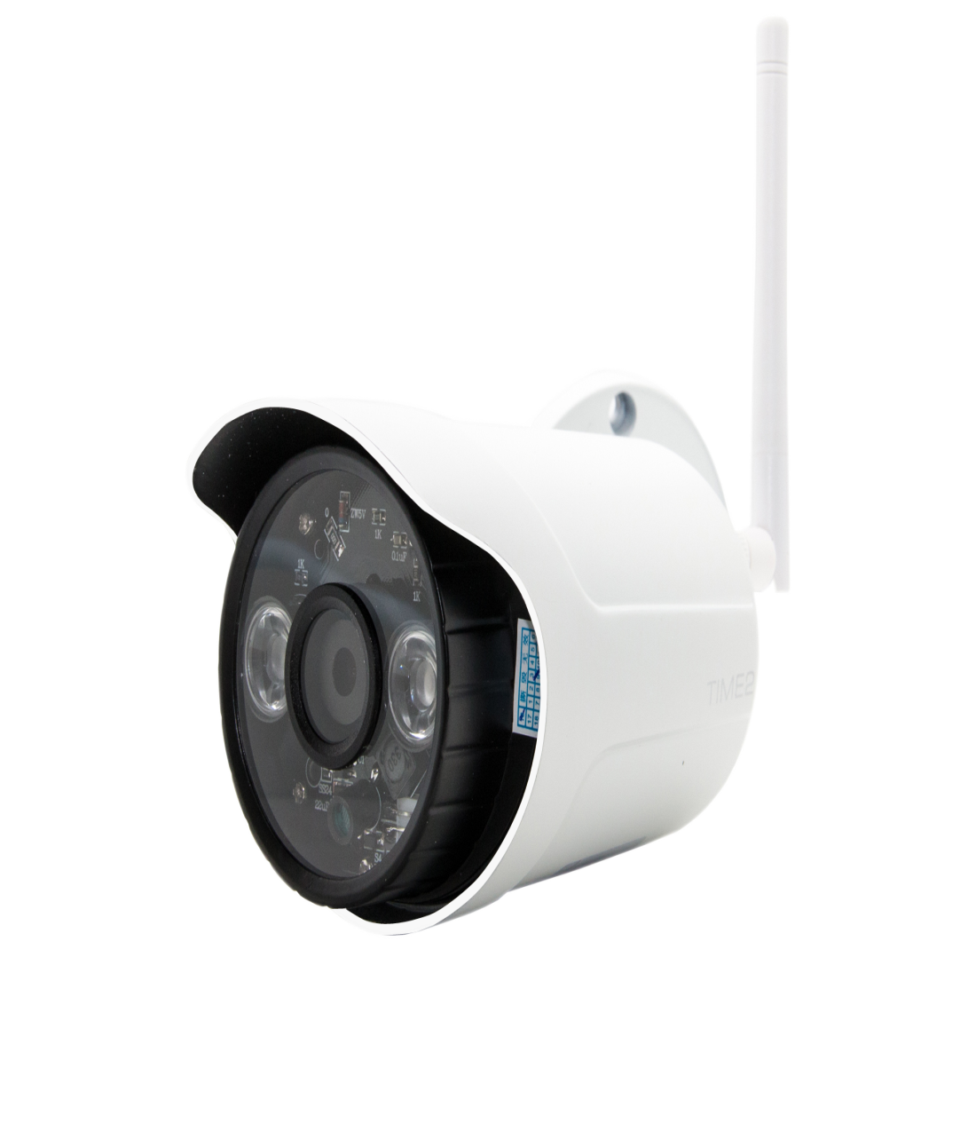
SPECIFICATIONS
Auto iris lens
Night Vision
Pan Tilt Zoon
View 450 ft away
Capture 30 images/sec
Vari focal length
Ocularis recording software
Audio and alarm features
Panoramic multisensor IP
Built in wifi radio

Slide 15
View 450 ft away
Panoramic multisensor IP
Built in wifi radio
Auto iris lens
Pan Tilt Zoon
SPECIFICATIONS
Vari focal length
Night Vision
Ocularis recording software
Capture 30 images/sec
Audio and alarm features

Slide 16


Thank you for listening!!
We welcome any questions you may have....

